Slide 1
Industry Engagement Groups on SAP
Friday 5th December 2014
Marriot Hotel, Cardiff

Slide 2
Milica Kitson
Chief Executive
Constructing Excellence in Wales

Slide 3
SAP Industry Engagement event
The Welsh Perspective
DECC/WG SAP workshop
05 December 2014
Francois Samuel
Building Regulations
Welsh Government
Notes:
3
3

Slide 4
Relevance of SAP to Wales and importance of this workshop
2014 Part L changes, differences with England, NHBC guidance for Wales
Non Energy policy - TAN22/Building Regulations review
Part L – what next for Wales?

Slide 5
EU Energy Performance in Buildings Directive – National Calculation Methodology
SAP
SBEM
Devolved Building Regulations – target setting
SAP dependencies – Part L, ECO, Green Deal, NEST, Arbed, WHQS
SAP fit for purpose?
New dwellings
Existing stock

Slide 6
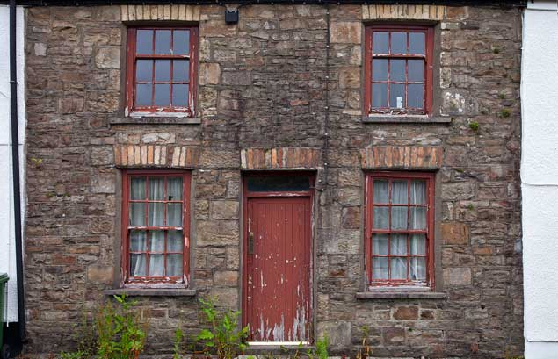

Slide 7
Part L 2014 changes Wales
SAP Wales update
SAP Differences with England
NHBC small builder guidance for Wales

Slide 8
Wales non energy issues
TAN22 planning policy review
Building regulations review topics 2015
Materials: sourcing, and life cycle impact;
Acoustic performance;
Information provision to the end user;
Energy efficiency (2016);
Lighting (2016);
Residential Security
Funding policy review

Slide 9
Part L – Where next for Wales
England route clear Zero Carbon in 2016
Infrastructure Bill – Carbon offsetting potential for Wales
Is reliance on natural ventilation still the benchmark?
Are we confident about increasing airtightness and reliance on technology e.g.MVHR
Review to commence 2015/16
Future proofing/adaptation issues

Slide 10
SAP Industry Engagement event
The Welsh Perspective
DECC/WG SAP workshop
05 December 2014
Francois Samuel
Building Regulations
Welsh Government
Notes:
10
10

Slide 11
SAP 2015 – Kick-off Cardiff
December 2014

Slide 12
Outline
Governance
Timeline for England
Process for identifying areas
Areas not covered this time
Areas proposed for review
Discussion
Next Steps

Slide 13
Split between Departments’ responsibilities. The departments are responsible for the policies in England, and for overseeing the work of the contractors or accredited body
Direct link between policy areas
Output delivered by contractor
NB: Many contractors are on the boundary
between departments as they work
under more than one contract on more than
one area for the two departments
England only. Different arrangements in Wales, Scotland and Northern Ireland

Slide 14
Government Department
DCLG
SAP Oversight Board includes E,S,W,NI
DECC
Building Regulations
Product standards (including ErP + MCS)
Current contractor or accredited delivery body
AECOM
(BR documents, SAP QA, SBEM validation, etc)
Building Regulations Advisory Committees (E,W,S,NI)
Advisory Body
SAP
Scientific Integrity Group
Policy
Part F+ L Building Regulations inc Approved Documents
BRE
(Model)
SAP
Energy Performance of Buildings Directive
Landmark
(Register, E&W)
RdSAP
SBEM
Building Energy Certification Policy
Green Deal (GB)
ECO (GB)
RHI
(GB)
Fuel Poverty (E)
Local authorities for building regulations compliance and trading standards
Schemes
(Software)
GDORB
Ofgem

Slide 15
Standard Assessment Procedure– High Level Milestone Plan for 2014/15
Workstream |  |  | Q1 (Apr-Jun 2014) | Q2 (Jul-Sep 2014) | Q3 (Oct-Dec 2014) | Q4 + (Jan-Mar 2015)
(1) SAP development |  |  | New Building Regulations come into force | ZCH “Performance Gap” report. SAPOB consider SAP 2016 priorities. Establish Working Groups on priority areas | SAPOB on Working Group feedback | BRE produce outline document to accompany technical papers. SAPOB on scope of consultation.
RdSAP development |  |  |  |  | New RdSAP software available | Scope changes for next version of RdSAP for 11/15
(2) Products Characteristics Database |  |  | PCDb changes (Ecodesign Directive) – early discussions with industry | PCDb changes (simplification) – Workshop | Start change implementation | Ensure scope of consultation changes for SAP include any necessary changes to Appendix Q
(3) Software validation |  |  |  | Validating RdSAP software
(4) Quality Assurance |  |  | 1st AECOM draft QA report. BRE send 2013/14 product testing results | 2nd AECOM report on international benchmarking. AECOM reports discussed in SAPOB. Await manufacturers’ response on tests | Prepare QA KPIs from 2015/16 based on reports
(5) Zero Carbon Homes/ Allowable Solutions |  |  |  | Passage of Infrastructure Bill (Allowable Solutions). | Scope SAP change in context of Zero Carbon Homes? | Contribute to preparation for Part L consultation by DCLG
(6) Local Authority Standards Review

Slide 16
Process after that…. * Produce Technical Working Papers and draft submission * Clear with SAPSIG * Clear with senior officials and Chief Scientific Advisor * Put submission to Ministers and write round to other Ministers in other Government Departments * Start public consultation Timings are election dependent – consultation will be after election

Slide 17
Process for prioritisation
Areas where we had already agreed to review this time round
Areas which would have the most significant impact on model outcome (ZC Hub)
Areas which frequently arose through the QA process which were not dependent on different assumptions about behaviour
Areas where there were researched credible, alternative values to put into the model

Slide 18
Let’s compare to what we said in 2012 consultation
Issue | How addressed in 2015
Overheating and space cooling | Reviews in 2015 (?) and 2018 (with DCLG evidence)
Use of solar panels for space heating | To review
Different types of low energy lighting in RdSAP | Low impact, review in 2018
Heating patterns | Possible change standard scenario – lose comparison
Desired internal temperature | No review
Introduction of a community heating database | Scope for database exists: review issue in SAP
Low temperature circulation to heat emitters in domestic heating systems | Already in SAP
Heating controls | Already under review – not sure whether evidence in time for 2015
Different types of ventilation | Some work in 2015; more in 2018
In-use factors | Review in DECC across piece (GD and ECO too) in 2015
Annual performance method for micro-CHP devices that provide hot water services only | Through Appendix Q for fuel cell CHP?
A review of occupancy factors | Water use: 2015 Others?

Slide 19
Areas not covered this time
Overheating – we think we want to wait for further research from DCLG and others, particularly if it leads to changes to ventilation requirements. However we might ask if wording in Appendix P incorrect?
Smarter heating controls – not sufficient evidence from research yet of consistent energy saving from particular type of control (eg room by room or geolocation). Can come through Appendix Q.
Hybrids – the key distinction from a hybrid is the algorithm which controls the relationship between the two heating supply solutions. Until we know this in detail or this is standardised for an outcome, hard to model. Then can come through Appendix Q .
Desired temperatures (18ºC upstairs, 21ºC downstairs)- we know this is not the average indoor temperature, but the levels are set to ensure the comfort of vulnerable – WHO
Psi – values – we are not sure what to review ahead of DCLG’s consideration of the Zero Carbon Hub’s recommendation on a new body for thermal bridging details
BR443 and BR497 – these are industry standards referenced in the Approved Document for Part L, not SAP
Thermal comfort – not clear how we would model this – looking at other countries

Slide 20
Areas not covered this time
We recommend research for the next version of SAP (2018) for:
Lighting, cooking, appliances – impact and internal gains (last reviewed in 2010)
Unusual buildings – reviewing SAP treatment of park homes
Overall model validation, including review of scope for dynamic models for hour by hour analysis of interaction between heating supply systems

Slide 21
Areas that SAPSIG are looking at
Making Appendix Q processes simpler
Considering if SAP should be provided as a core piece of software rather than a core methodology (as with SBEM)

Slide 22
Areas we propose reviewing
Some Appendix S U-values – in particular solid wall
Thermal bridging (?)
Carbon emissions/fuel factors
Ventilation – modelling of energy use against current Part F scenarios, especially demand controlled and chimneys
Community heating
Hot water demand – electric showers and WWHR
New boiler testing methodologies – impact of ErP (PCDb)
New heat pump testing methodologies – impact of ErP (PCDb)
Technology cost data on EPC (not SAP, but…)
Biomass boiler default values
MIS 3005 heat pump default values
Solar storage volume factor/solar space heating
Assumptions on back-up for electric storage heating? EFUS?
Overheating wording?

Slide 23
Conclusion
Reviewed SAP across the piece.
Prioritised on basis of significance to model and availability of research
Have a timetable to 2016
Looking for feedback now before it is too late to turn the tanker round

Slide 24
Discussion on next steps
Particular issues of importance to Welsh stakeholders?
Timetable in Wales?
Other areas which meet the prioritisation requirements, especially where research is available or new standards have been set?

Slide 25
Definition
Methodology for calculating the energy performance of buildings
Member States shall adopt, either at national or regional level, a methodology for calculating the energy performance of buildings which takes into account certain elements, specifically:
•the thermal characteristics of a building (thermal capacity, insulation, etc.);
•heating insulation and hot water supply;
•the air-conditioning installation;
•the built-in lighting installation;
•indoor climatic conditions.
The positive influence of other aspects such as local solar exposure, natural lighting, electricity produced by cogeneration and district or block heating or cooling systems are also taken into account.
Setting minimum requirements
Member States shall put in place, in compliance with the aforementioned calculation methodology, minimum requirements for energy performance in order to achieve cost-optimal levels. The level of these requirements is reviewed every 5 years.
When setting requirements, Member States may differentiate between new and existing buildings and between different categories of buildings.

Slide 26
1. The energy performance of a building shall be determined on the basis of the calculated or actual annual energy that is consumed in order to meet the different needs associated with its typical use and shall reflect the heating energy needs and cooling energy needs (energy needed to avoid overheating) to maintain the envisaged temperature conditions of the building, and domestic hot water needs.
2. The energy performance of a building shall be expressed in a transparent manner and shall include an energy performance indicator and a numeric indicator of primary energy use, based on primary energy factors per energy carrier, which may be based on national or regional annual weighted averages or a specific value for on-site production. The methodology for calculating the energy performance of buildings should take into account European standards and shall be consistent with relevant Union legislation, including Directive 2009/28/EC.
3.
The methodology shall be laid down taking into consideration at least the following aspects:
(a) the following actual thermal characteristics of the building including its internal partitions:
(i) thermal capacity;
(ii) insulation;
(iii) passive heating;
(iv) cooling elements; and
(v) thermal bridges;

Slide 27
(b) heating installation and hot water supply, including their insulation characteristics;
(c) air-conditioning installations;
(d) natural and mechanical ventilation which may include air-tightness;
(e) built-in lighting installation (mainly in the non-residential sector);
(f) the design, positioning and orientation of the building, including outdoor climate;
(g) passive solar systems and solar protection;
(h) indoor climatic conditions, including the designed indoor climate;
(i) internal loads.

Slide 28
.
4. The positive influence of the following aspects shall, where relevant in the calculation, be taken into account:
(a) local solar exposure conditions, active solar systems and other heating and electricity systems based on energy from renewable sources;
(b) electricity produced by cogeneration;
(c) district or block heating and cooling systems;
(d) natural lighting.
5. For the purpose of the calculation buildings should be adequately classified into the following categories:
(a) single-family houses of different types;
(b) apartment blocks;
(c) offices;
(d) educational buildings;
(e) hospitals;
(f) hotels and restaurants;
(g) sports facilities;
(h) wholesale and retail trade services buildings;
(i) other types of energy-consuming buildings.

Slide 29
Zero Carbon Hub & The performance gap
Ross Holleron, Projects Director
5th December2014

Slide 30
Overview
What We Do
Performance Gap
Project Background
Evidence Review & Example Issues
Areas for Change
Headline recommendations for Industry and Government

Slide 31
Performance gap
Design vs As Built Performance – New Homes

Slide 32
Ambition - Carbon Compliance report, Recommendation 4a:
Closing the Performance Gap – the 2020 Ambition:
“From 2020, be able to demonstrate that at least 90% of all new homes meet or perform better than the designed energy / carbon performance”
1. Map out the journey to achieve this target:
2013 2016 2020
2. Develop a mechanism to demonstrate achievement:
Assuring performance
Motivating improvement through feedback loop

Slide 33
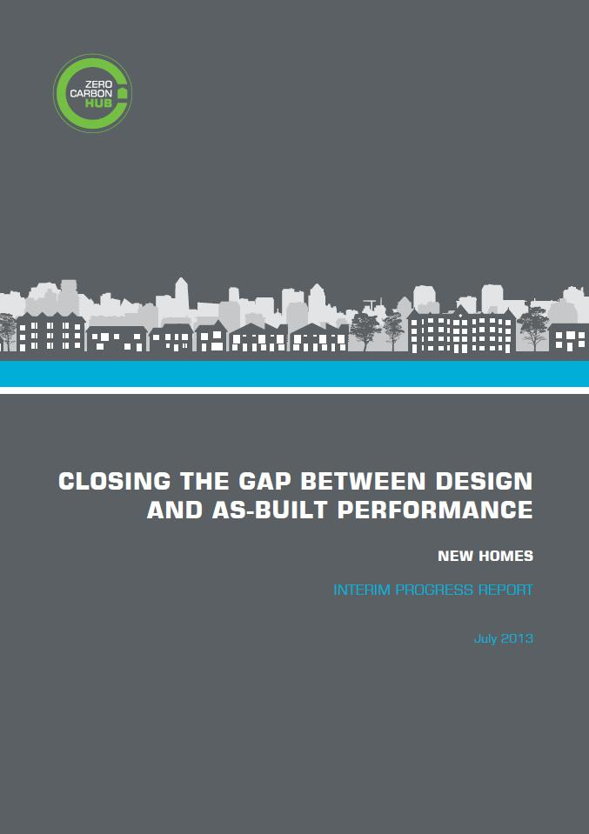
Interim Progress Report
What might be happening to create the Performance Gap?
60 potential issues identified:
Acquisition, concept design & planning
Detailed design
Procurement
Construction & commissioning
Verification
Testing
Energy modelling tools & conventions
Overarching

Slide 34
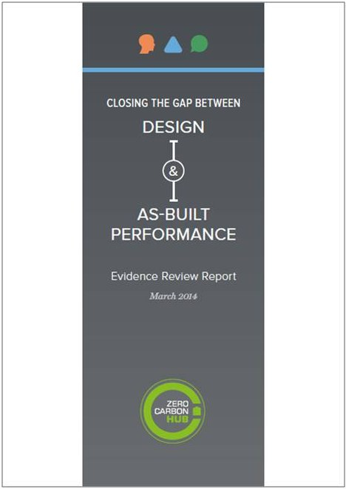
Evidence Review Report
Which issues should we focus on?
- Literature Review
Housebuilder Process Review
- Questionnaires
- SAP sensitivity analysis

Slide 35
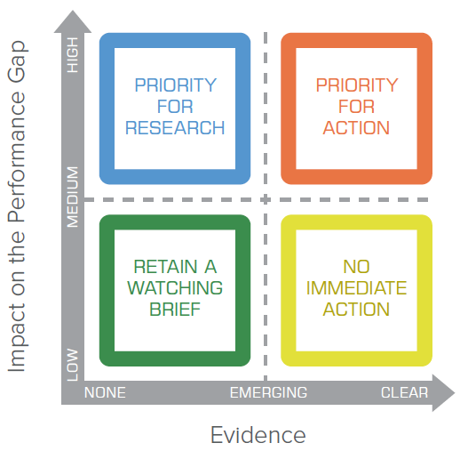
Evidence Review Report – prioritising issues

Slide 36
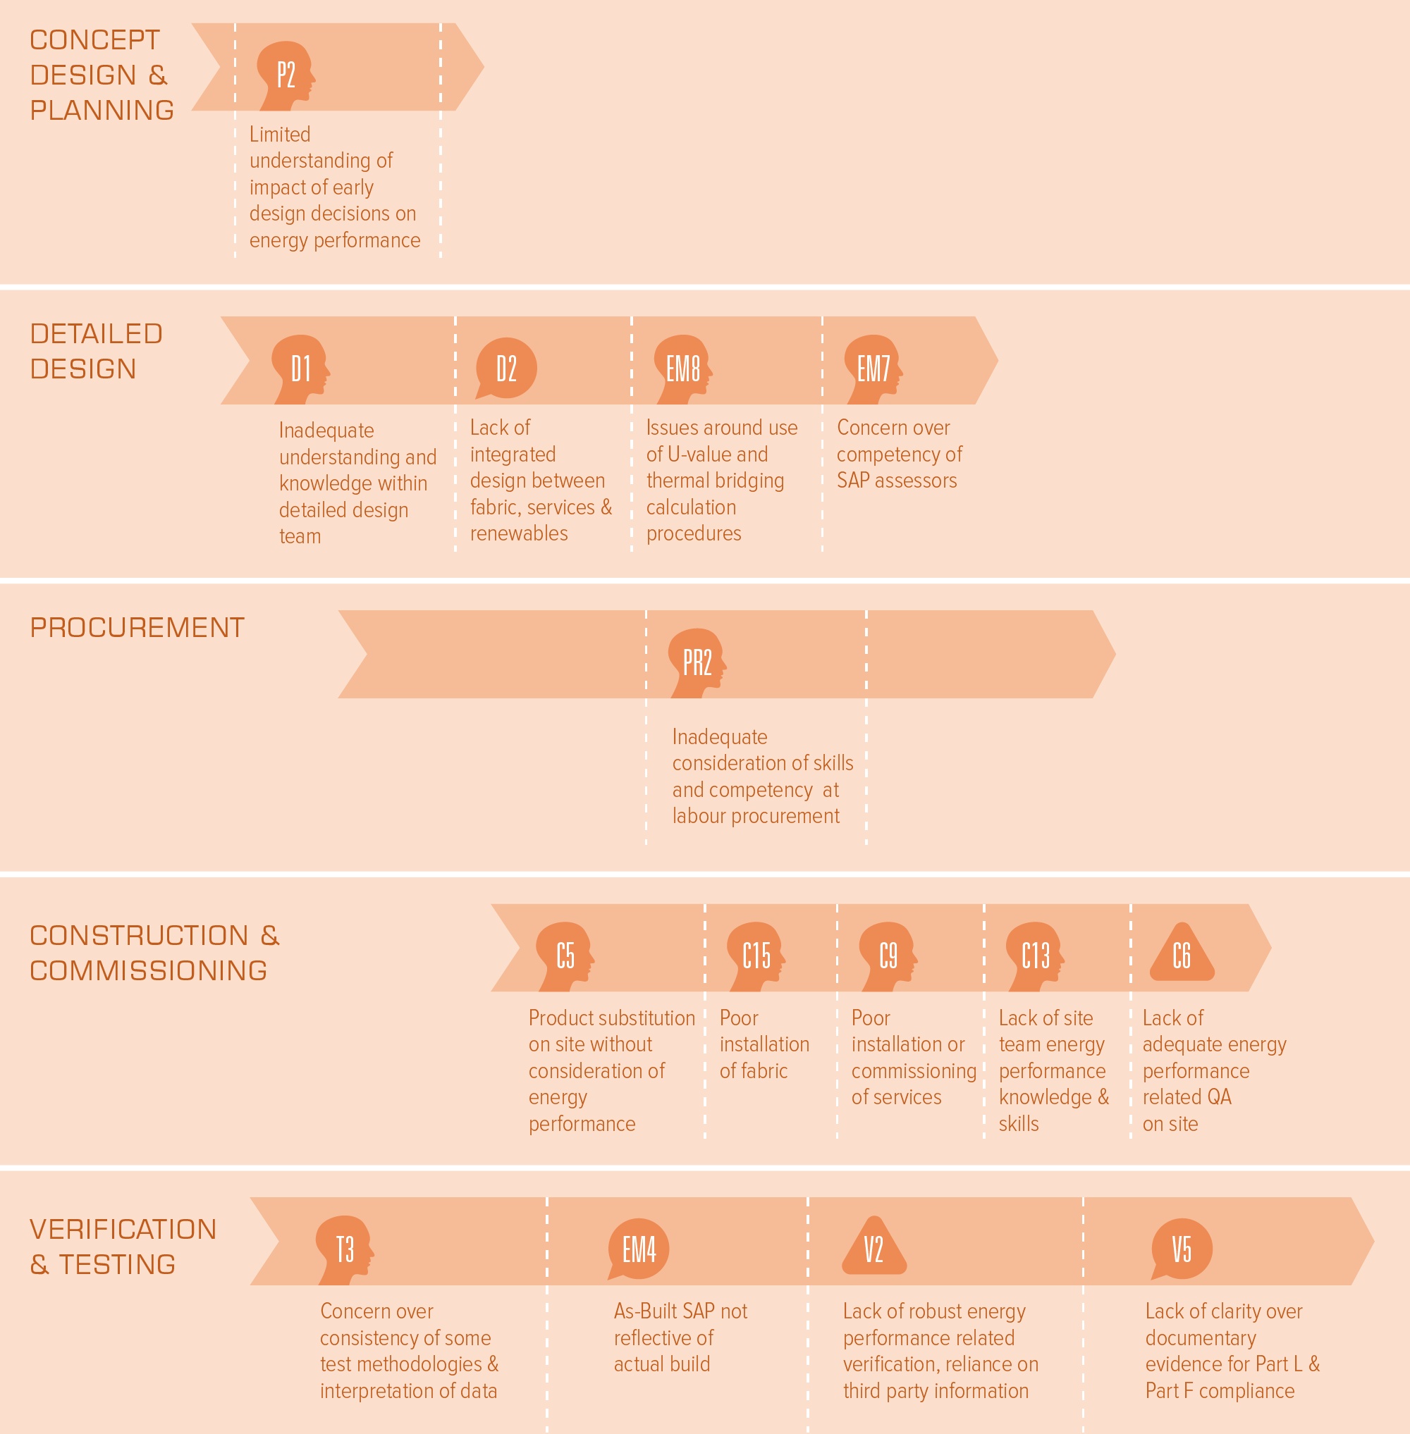
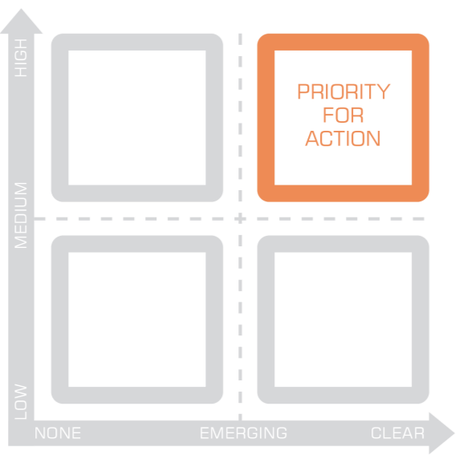
Examples

Slide 37
Competency of SAP Assessors
Problems with:
Accuracy of inputs
Following conventions
Validating assumptions
Evidencing assessments
Significant impact where they are giving design advice

Slide 38
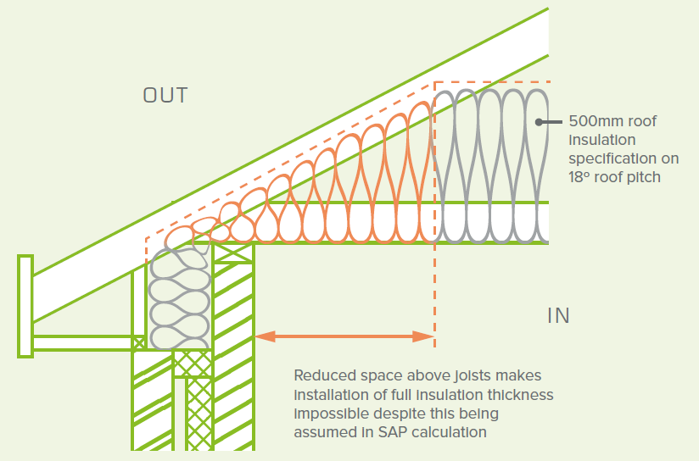
How is the u-value calculated?
Can’t assume same thickness across entire roof

Slide 39
SAP Questionaires & Audits
Tailored to specific areas:
5 main SAP Accreditation Organisations
150 SAP Assessors
Typical Assessor issues:
Only 40% asked to model in time to influence structure
70% found no information of thermal bridging from design team
Common errors in measurement, thermal mass & heating

Slide 40
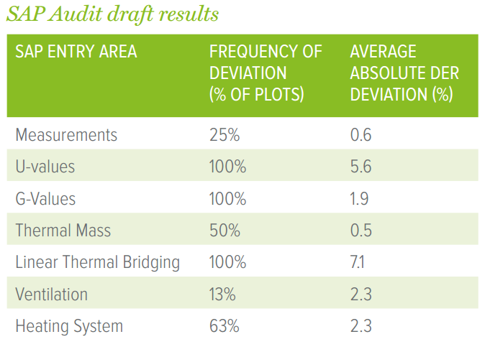
As-Built SAP evidence

Slide 41
Understanding & Knowledge within Design Team
Impact on:
Buildability
Compatibility of systems, materials and services
Thermal detailing
Typical examples:
Details into which insulation is impossible to fit
No detail on support of screed at ground floor perimeters
No consideration of thermal bridges for rooms over garages

Slide 42
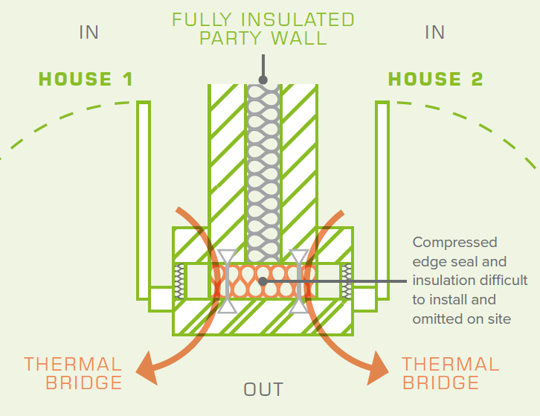
Design Assumed:
Wall ties
Compressed edge seal
Insulation

Slide 43
Reality:
Wall ties
Compressed edge seal
Insulation

Slide 44
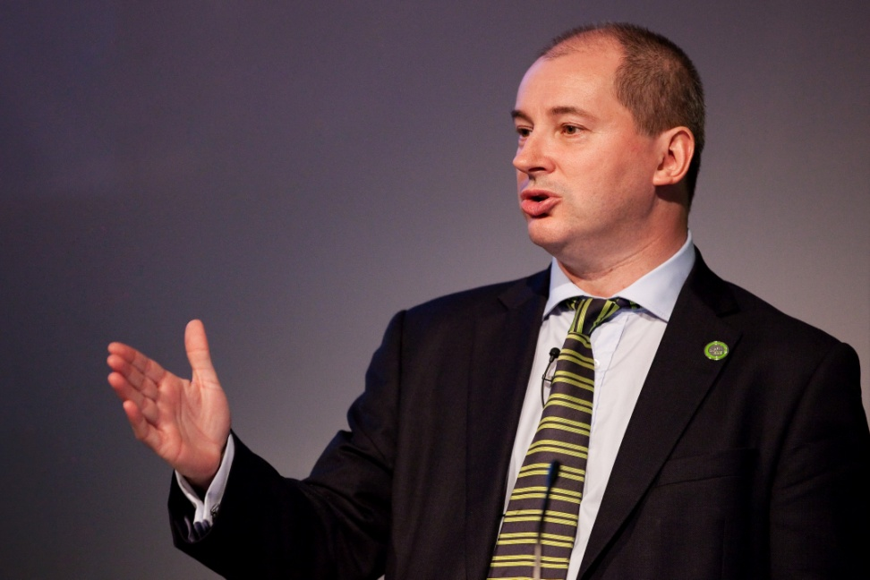
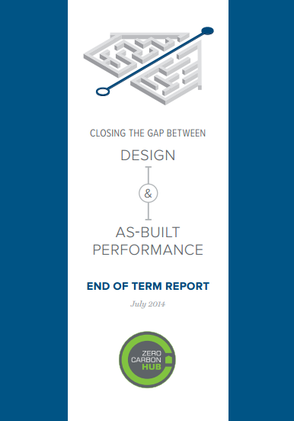
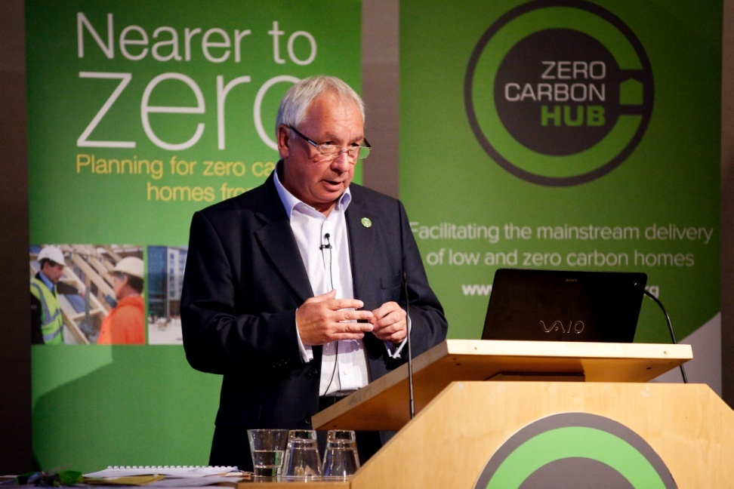
End of Term Report
Launched 8th July 2014
Stephen Williams MP – DCLG
Stephen Stone – Crest Nicholson

Slide 45
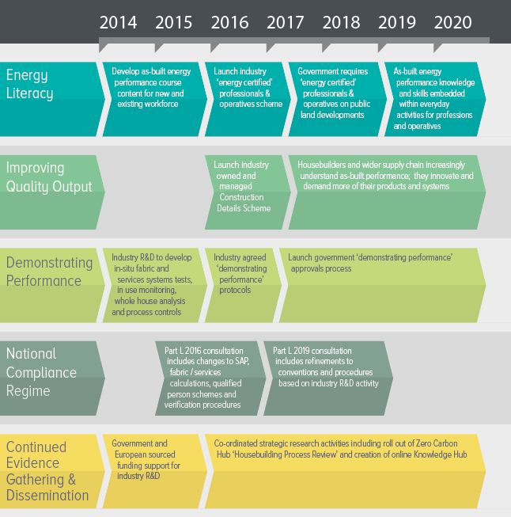
Areas for change

Slide 46
SAP & Part L Specific Recommendations
Need for action
A significant & widespread Performance Gap exists
It occurs across all stages of the process
Key areas for change:
SAP Process – Improved Compliance Reporting
Governance of SAP Schemes and Assessors
Improved U-value and Psi-Value Calculations
Review of SAP methodology and Assumptions
Changes to SAP Software
46

Slide 47
Thank you
Stay in touch:
www.zerocarbonhub.org
Ross.holleron@zerocarbonhub.org

Slide 48
Questions?

